Slide 1
Statistics for Managers
Using Microsoft® Excel 5th Edition
Chapter 6 (Textbook Ch8)
Confidence Interval Estimation

Slide 2
Chapter Goals
After completing this chapter, you should understand:
Point estimate and a confidence interval estimate
Confidence interval estimate for a single population mean
Confidence interval estimate for a single population
proportion
Determining the required sample size to estimate a mean
or proportion within a specified margin of error

Slide 3
Confidence Intervals
Content of this chapter
Confidence Intervals for the Population
Mean, μ
when Population Standard Deviation σ is Known
when Population Standard Deviation σ is Unknown
Confidence Intervals for the Population
Proportion, p
Determining the Required Sample Size

Slide 4
Point and Interval Estimates
A point estimate is a single number
A confidence interval provides additional
information about variability
Lower
Confidence
Limit
Upper
Confidence
Limit
Point Estimate
Width of
confidence interval

Slide 5
Point Estimates
We can estimate a
Population Parameter …
with a Sample Statistic
(a Point Estimate)
Mean
μ
X
Proportion
p
p_{s}

Slide 6
Confidence Intervals
How much uncertainty is associated with a point estimate of a population parameter?
An interval estimate provides more information about a population characteristic than does a point estimate
Such interval estimates are called confidence intervals

Slide 7
Confidence Interval Estimate
An interval gives a range of values:
Takes into consideration variation in sample statistics from sample to sample
Based on observation from 1 sample
Gives information about closeness to unknown population parameters
Stated in terms of level of confidence
Can never be 100% confident

Slide 8
Estimation Process
Random Sample
I am 95% confident that μ is between 40 & 60.
Population
Mean
X = 50
(mean, μ, is unknown)
Sample

Slide 9
Why does it work?
is within of its mean μ about 95% of the time
Because is an estimator of (the standard deviation of the sampling distribution of )
This also says that μ is within of about
95% of the time
μ
μ

Slide 10
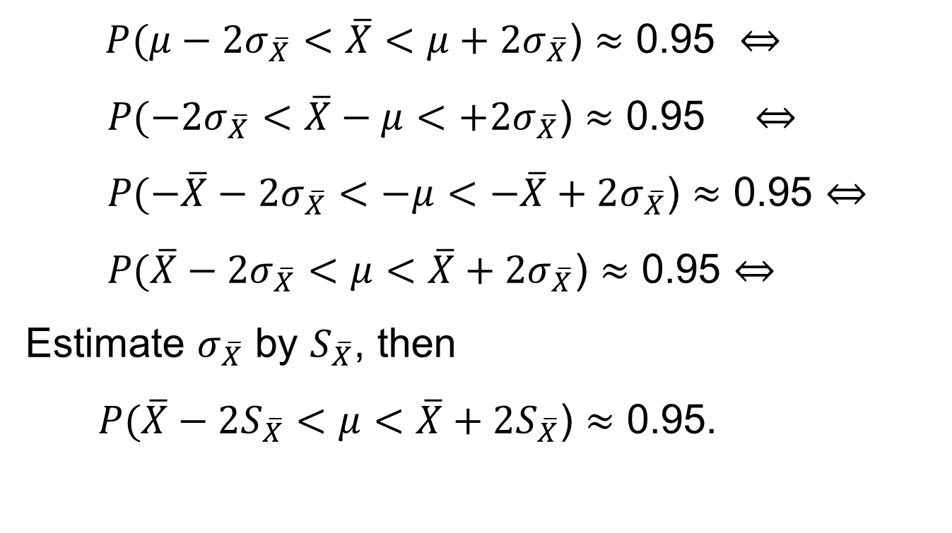
Why does it work?

Slide 11
Imagine Many Samples
Other intervals you
might have computed
Missed!
Missed!
The interval you computed
22
23
24
The population mean = 23.29

Slide 12
General Formula
The general formula for all
confidence intervals is:
Point Estimate ± (Critical Value)(Standard Error)

Slide 13
Confidence Level
Confidence Level
Confidence in which the interval
will contain the unknown
population parameter
A percentage (less than 100%)

Slide 14
Confidence Level, (1-α)
(continued)
Suppose confidence level = 95%
Also written (1 - α) = .95
A relative frequency interpretation:
In the long run, 95% of all the confidence
intervals that can be constructed will contain the
unknown true parameter
A specific interval either will contain or will
not contain the true parameter
No probability involved in a specific interval

Slide 15
Confidence Intervals
Confidence
Intervals
Population
Mean
Population
Proportion
σ Known
σ Unknown

Slide 16
Confidence Interval for μ (σ Known)
Assumptions
Population standard deviation σ is known
Population is normally distributed
If population is not normal, use large sample
Confidence interval estimate:
(where Z is the normal distribution critical value for a probability of α/2 in each tail)

Slide 17
Finding the Critical Value, Z
Consider a 95% confidence interval:
Z units:
Z= -1.96
0
Z= 1.96
X units:
Lower
Confidence
Limit
Upper
Confidence
Limit
Point Estimate
Point Estimate

Slide 18
Common Levels of Confidence
Commonly used confidence levels are 90%,
95%, and 99%
Confidence Coefficient,
Confidence Level
Z value
80%
90%
95%
98%
99%
99.8%
99.9%
.80
.90
.95
.98
.99
.998
.999
1.28
1.645
1.96
2.33
2.58
3.08
3.27

Slide 19
Intervals and Level of Confidence
Sampling Distribution of the Mean
x
Intervals extend from
to
x₁
x₂
(1-α)x100% of intervals constructed contain μ;
(α)x100% do not.
Confidence Intervals

Slide 20
Example
A sample of 11 circuits from a large normal
population has a mean resistance of 2.20
ohms. We know from past testing that the
population standard deviation is .35 ohms.
Determine a 95% confidence interval for
the true mean resistance of the population.

Slide 21
Example
(continued)
A sample of 11 circuits from a large normal
population has a mean resistance of 2.20
ohms. We know from past testing that the
population standard deviation is .35 ohms.
Solution:

Slide 22
Interpretation
We are 95% confident that the true mean
resistance is between 1.9932 and 2.4068
ohms
Although the true mean may or may not
be in this interval, 95% of intervals formed
in this manner will contain the true mean

Slide 23
Confidence Intervals
Confidence
Intervals
Population
Mean
Population
Proportion
σ Known
σ Unknown

Slide 24
Confidence Interval for μ (σ Unknown)
If the population standard deviation σ is
unknown, we can substitute the sample
standard deviation, S
This introduces extra uncertainty, since
S is variable from sample to sample
So we use the t distribution instead of the
normal distribution

Slide 25
Confidence Interval for μ (σ Unknown)
(continued)
Assumptions
Population standard deviation is unknown
Population is normally distributed
If population is not normal, use large sample
Use Student’s t Distribution
Confidence Interval Estimate:
(where t is the critical value of the t distribution with n-1 d.f. and an area of α/2 in each tail)

Slide 26
Student’s t Distribution
The t is a family of distributions
The t value depends on degrees of
freedom (d.f.)
Number of observations that are free to vary after
sample mean has been calculated
d.f. = n - 1

Slide 27
Degrees of Freedom (df)
Idea: Number of observations that are free to vary
after sample mean has been calculated
Example: Suppose the mean of 3 numbers is 8.0
Let X₁ = 7
Let X₂ = 8
What is X₃?
If the mean of these three values is 8.0,
then X₃ must be 9
(i.e., X₃ is not free to vary)
Here, n = 3, so degrees of freedom = n – 1 = 3 – 1 = 2
(2 values can be any numbers, but the third is not free to vary for a given mean)

Slide 28
Student’s t Distribution
Note: t Z as n increases
Standard Normal
(t with df = ∞)
t (df = 13)
t-distributions are bell-shaped and symmetric, but have ‘fatter’ tails than the normal
t (df = 5)
t
0

Slide 29
Student’s t Table
Upper Tail Area
Let: n = 3 df = n - 1 = 2 α = .10 α/2 =.05
df
.25
.10
.05
1
1.000
3.078
6.314
2
0.817
1.886
2.920
3
0.765
1.638
2.353
α/2 =.05
The body of the table contains t values, not probabilities
0
2.920
t

Slide 30
t distribution values
With comparison to the Z value
Confidence t t t Z
Level (10 d.f.) (20 d.f.) (30 d.f.) ____
.80 1.372 1.325 1.310 1.28
.90 1.812 1.725 1.697 1.64
.95 2.228 2.086 2.042 1.96
.99 3.169 2.845 2.750 2.58
Note: t Z as n increases

Slide 31
Example
A random sample of n = 25 has X = 50 and
S = 8. Form a 95% confidence interval for μ
d.f. = n – 1 = 24, so
The confidence interval is
(46.698 , 53.302)

Slide 32
Confidence Intervals
Confidence
Intervals
Population
Mean
Population
Proportion
σ Known
σ Unknown

Slide 33
Confidence Intervals for the Population Proportion, p
An interval estimate for the population
proportion ( p ) can be calculated by
adding an allowance for uncertainty to
the sample proportion ( p_{s} )

Slide 34
Confidence Intervals for the Population Proportion, p
(continued)
Recall that the distribution of the sample
proportion is approximately normal if the
sample size is large, with standard deviation
We will estimate this with sample data:

Slide 35
Confidence Interval Endpoints
Upper and lower confidence limits for the
population proportion are calculated with the
formula
where
Z is the standard normal value for the level of confidence desired
p_{s} is the sample proportion
n is the sample size

Slide 36

Example
A random sample of 100 people shows that 25 are left-handed.
Form a 95% confidence interval for the true proportion of left-handers

Slide 37
Example
(continued)
A random sample of 100 people shows
that 25 are left-handed. Form a 95%
confidence interval for the true proportion
of left-handers.

Slide 38
Interpretation
We are 95% confident that the true
percentage of left-handers in the
population is between 16.51% and 33.49%.
Although the interval from .1651 to .3349
may or may not contain the true
proportion, 95% of intervals formed from
samples of size 100 in this manner will
contain the true proportion.

Slide 39
Determining Sample Size
Determining
Sample Size
For the
Mean
For the
Proportion

Slide 40
Sampling Error
The required sample size can be found to
reach a desired margin of error (e) with a
specified level of confidence (1 - α)
The margin of error is also called sampling error
the amount of imprecision in the estimate of the
population parameter
the amount added and subtracted to the point
estimate to form the confidence interval

Slide 41
Determining Sample Size
Determining
Sample Size
For the
Mean
Sampling error (margin of error)

Slide 42
Determining Sample Size
(continued)
Determining
Sample Size
For the
Mean
Now solve for n to get

Slide 43
Determining Sample Size
(continued)
To determine the required sample size for the
mean, you must know:
The desired level of confidence (1 - α), which
determines the critical Z value
The acceptable sampling error (margin of error), e
The standard deviation, σ

Slide 44
Required Sample Size Example
If σ = 45, what sample size is needed to estimate the mean within ± 5 with 90% confidence?
So the required sample size is n = 220
(Always round up)

Slide 45
If σ is unknown
If unknown, σ can be estimated when using the required sample size formula
Use a value for σ that is expected to be at least as large as the true σ
Select a pilot sample and estimate σ with the sample standard deviation, S

Slide 46
Determining Sample Size
Determining
Sample Size
For the
Proportion
Sampling error (margin of error)

Slide 47
Determining Sample Size
(continued)
Determining
Sample Size
For the
Proportion
Now solve for n to get

Slide 48
Determining Sample Size
(continued)
To determine the required sample size for the
proportion, you must know:
The desired level of confidence (1 - α), which
determines the critical Z value
The acceptable sampling error (margin of error), e
The true proportion of “successes”, p
p can be estimated with a pilot sample, if
necessary (or conservatively use p = .50)

Slide 49
Required Sample Size Example
How large a sample would be necessary to estimate the true proportion defective in a large population within ±3%, with 95% confidence?
(Assume a pilot sample yields p_{s} = .12)

Slide 50
Required Sample Size Example
(continued)
Solution:
For 95% confidence, use Z = 1.96
e = .03
p_{s} = .12, so use this to estimate p
So use n = 451

Slide 51
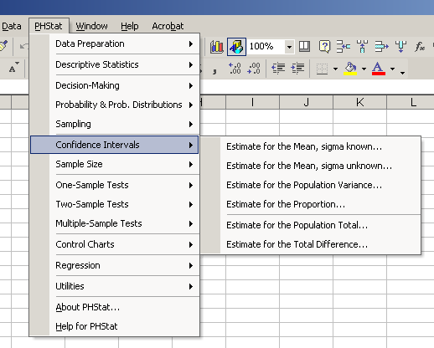
PHStat Interval Options
options

Slide 52
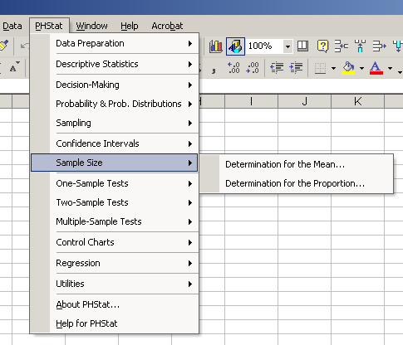
PHStat Sample Size Options

Slide 53
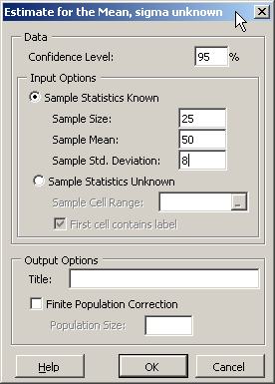
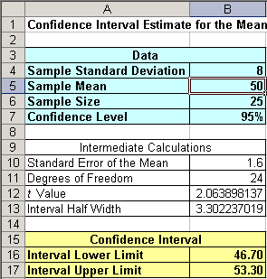
Using PHStat (for μ, σ unknown)
A random sample of n = 25 has X = 50 and
S = 8. Form a 95% confidence interval for μ

Slide 54
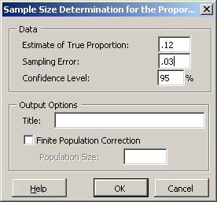
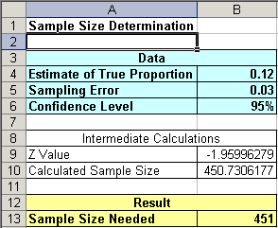
Using PHStat (sample size for proportion)
How large a sample would be necessary to estimate the true proportion defective in a large population within 3%, with 95% confidence?
(Assume a pilot sample yields p_{s} = .12)

Slide 55
Confidence Interval for Population Total Amount
Point estimate:
Confidence interval estimate:
(This is sampling without replacement, so use the finite population correction in the confidence interval formula)

Slide 56
Confidence Interval for Population Total: Example
A firm has a population of 1000 accounts and wishes to estimate the total population value.
A sample of 80 accounts is selected with average balance of $87.6 and standard deviation of $22.3.
Find the 95% confidence interval estimate of the total balance.

Slide 57
Example Solution
The 95% confidence interval for the population total balance is $82,837.52 to $92,362.48

Slide 58
Confidence Interval for Total Difference
Point estimate:
Where the average difference, D, is:

Slide 59
Confidence Interval for Total Difference
(continued)
Confidence interval estimate:
where

Slide 60
One Sided Confidence Intervals
Application: find the upper bound for the
proportion of items that do not conform with
internal controls
where
Z is the standard normal value for the level of confidence desired
p_{s} is the sample proportion of items that do not conform
n is the sample size
N is the population size

